Slide 1
Agility: Step 1: Discipline Step 2: Make awesome
Arlo Belshee
@arlobelshee, http://arlobelshee.com/

Slide 2

Most people have never seen 2-star success
Silver Platter transition

Slide 3
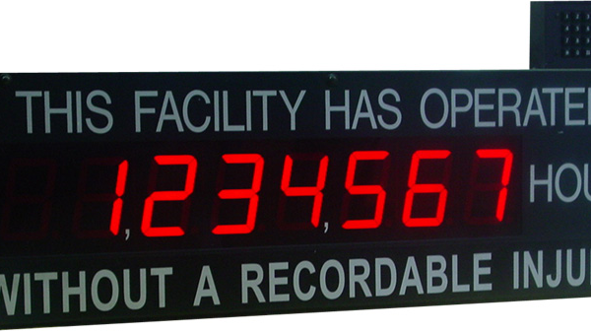
Zero bugs: WRITE < 1 bug per fortnight per team
Microsoft Online Store

Slide 4
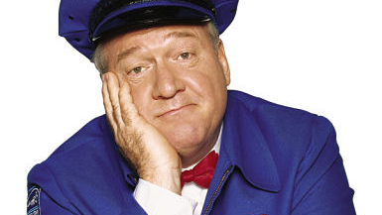
Zero bugs: Bug DB median size 0; max size 1
Smile Box

Slide 5

Finish 95% of tasks within +/- 5% of prediction
Blue Tech

Slide 6

Prioritize based on value alone
Corey Haines

Slide 7
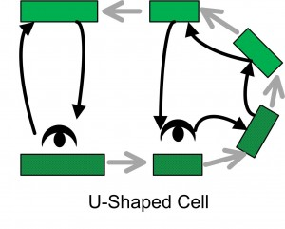
Every work item can be done by anyone
Menlo Innovation

Slide 8
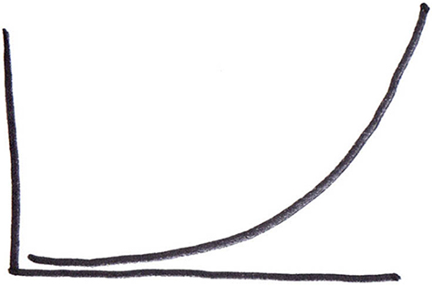
Productivity doubles every 2 years
Hunter Technologies

Slide 9

Legacy code gives 3x productive BOOST
James Shore internationalization refactoring

Slide 10
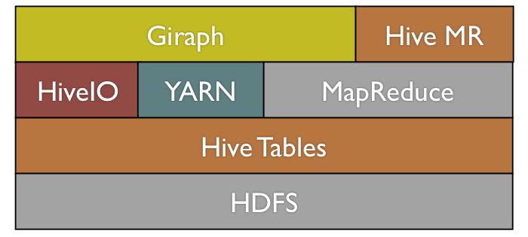
> 90% of code is borrowed or shared
Facebook

Slide 11
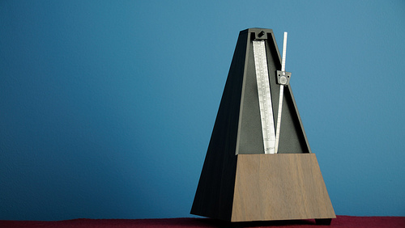
Ship option hourly or faster
Flickr

Slide 12
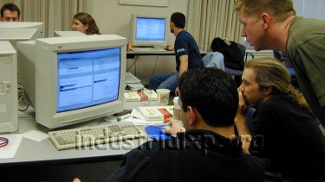
All stakeholders involved from start
Merrill Lynch

Slide 13
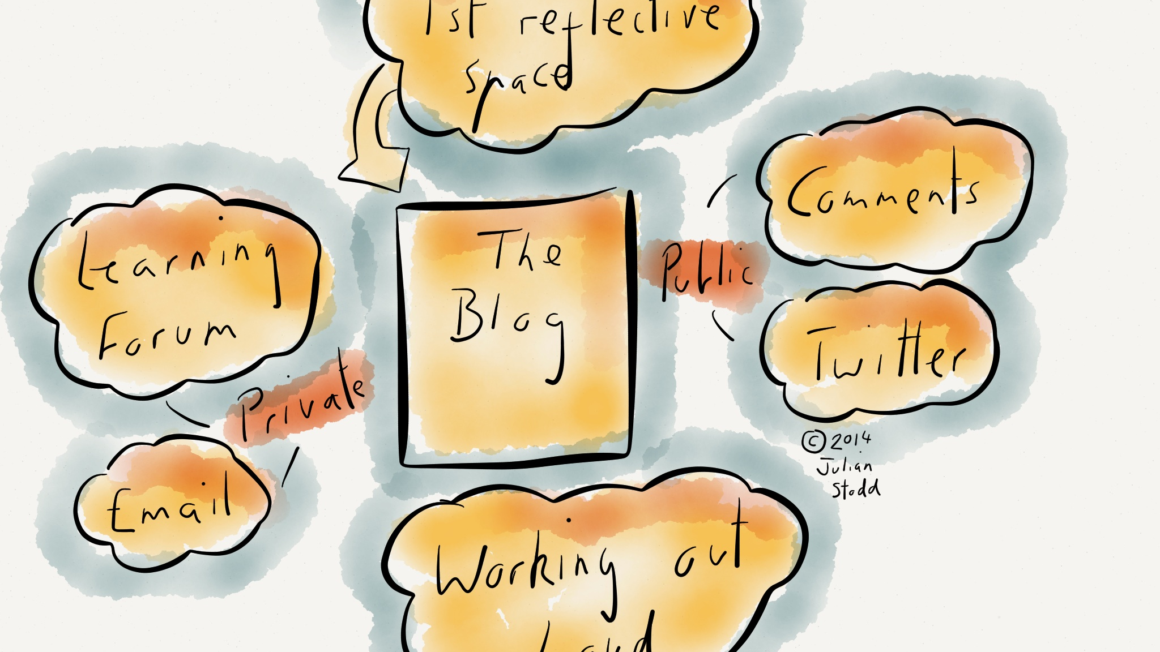
Transparent and invite decision collaboration
Yammer – annual budgeting

Slide 14
Average 2-star results - Discipline
Change direction on a dime with no sunk costs
Write < 1 bug per fortnight per team
Bug DB median size is 0; max is 1
Finish > 95% of work within +/- 5% of prediction
Can prioritize work based on value alone
Every work item can be done by anyone
35% YoY productivity gain
Legacy code gives 3x productivity boost
90% of the code is borrowed / shared
Ship option hourly or faster
All stakeholders involved from start
Transparent and invite decision collaboration

Slide 15
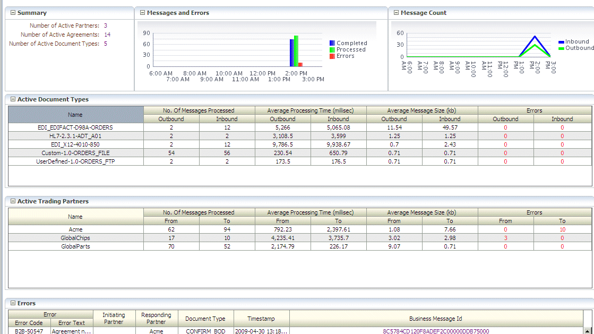
Metrics-driven development
Yammer

Slide 16

Hypothesis-driven development
Lean startup

Slide 17
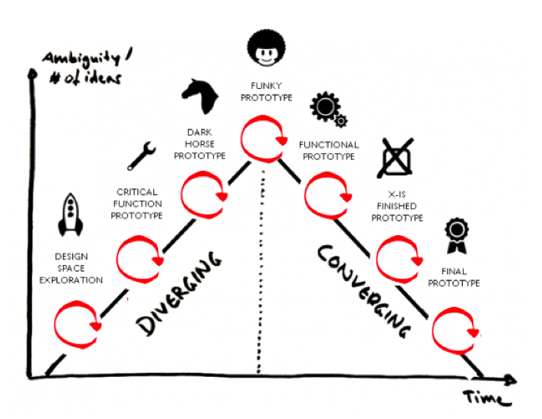
Customer development / design thinking
Nordstrom Innovation Lab

Slide 18
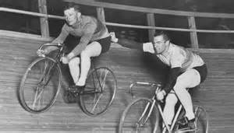
Coopetition
Derek Neighbors

Slide 19
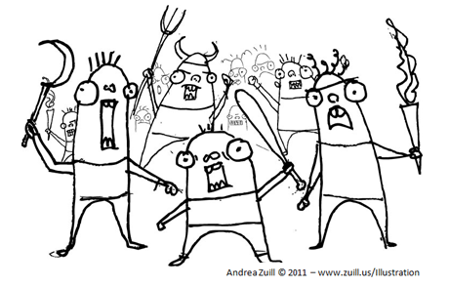
Mobs
Hunter Technologies

Slide 20
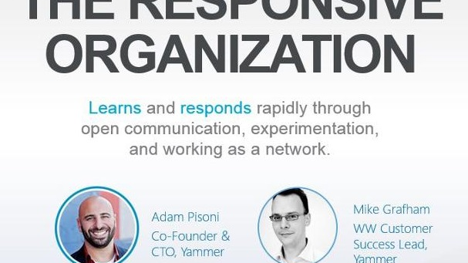
Responsive organization
Red Robin

Slide 21
TL;DR
Awesome discipline is awesome
Very few teams have it
Most teams think they do…until they see someone who actually does
But some teams have discipline
And then build on that to make really awesome
Just make sure you have the discipline to support the awesome

Slide 22
Agility: Step 1: Discipline Step 2: Make awesome
Arlo Belshee
@arlobelshee, http://arlobelshee.com/

